Slide 1
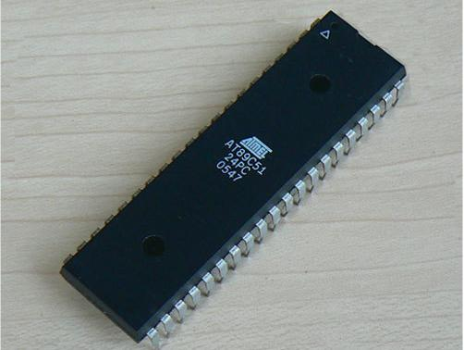
MICROCONTROLLER & ITS INTERFACING
HARINDRA CHALLAGOLLA
161LA05015

Slide 2
Topics of Discussion:
Microcontroller 8051
Definition
Microprocessor Vs Microcontroller
8051 Features
Block Diagram of 8051
Manufacturers
Pin diagram of 8051
Addressing Modes

Slide 3
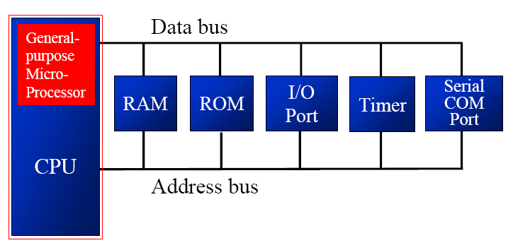
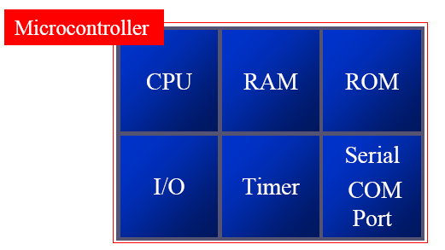
Microprocessor Vs Microcontroller:

Slide 4
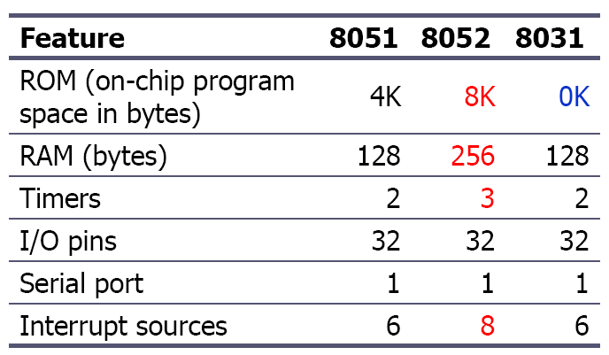
Microcontroller 8051 Features:

Slide 5
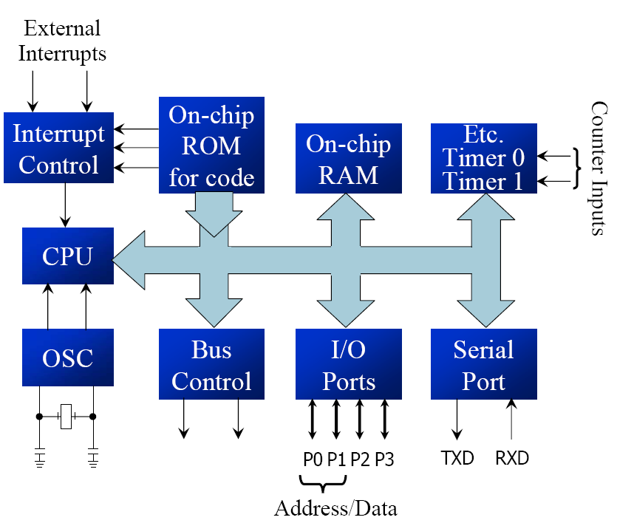
8051 Block Diagram:

Slide 6
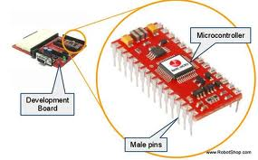
Manufacturers of 8051:
Intel
Atmel
Phillips
Dallas
Motorola
National
Infineon

Slide 7
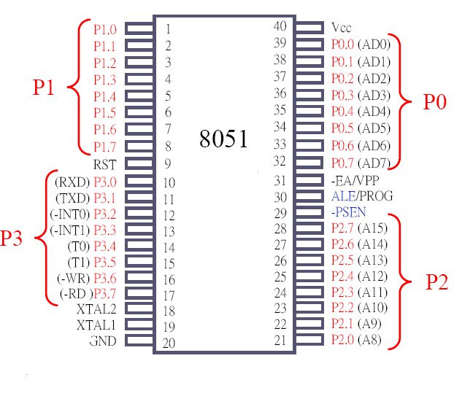

Pin Diagram-8051:

Slide 8
Addressing Modes:
Immediate Addressing Mode
Direct Addressing Mode
Register Addressing Mode
Register Indirect Addressing Mode
Indexed Addressing Mode

Slide 9
Addressing Modes (cont.):
Immediate Addressing Mode :
MOV A, #64H
MOV R1, #0FFH
Direct Addressing Mode:
MOV A, 64H
MOV A, 0FFH

Slide 10
Addressing Modes (cont.):
Register Addressing Mode
MOV A, R0
MOV R1, A
Register Indirect Addressing Mode
MOV A,@R0
MOV @R1,A

Slide 11
Real World Interfacing:
Simple Input- Output Concept:
Interfacing Switch
Interfacing LED

Slide 12
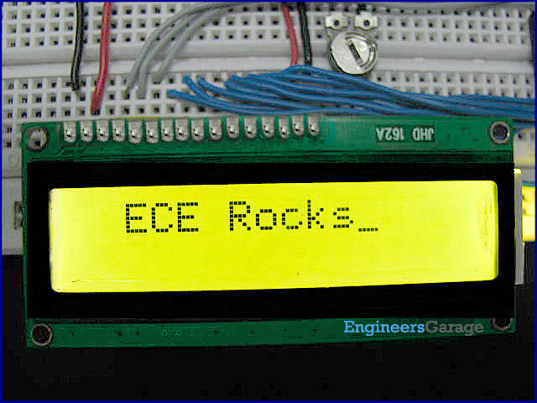
LCD Interfacing:
16X2 LCD Module

Slide 13
Pin Description:
Pin | Symbol | I/O | Description
1 | Vs | - | Ground
2 | Vcc | - | +5 V
3 | V_{EE} | - | Contrast control
4 | RS | I | Register Select
5 | R/W | I | Read/Write
6 | E | I/O | Enable
7 | DB0 | I/O | 8 bit data bus
8 | DB1 | I/O | 8 bit data bus
9 | DB2 | I/O | 8 bit data bus
10 | DB3 | I/O | 8 bit data bus
11 | DB4 | I/O | 8 bit data bus
12 | DB5 | I/O | 8 bit data bus
13 | DB6 | I/O | 8 bit data bus
14 | DB7 | I/O | 8 bit data bus

Slide 14
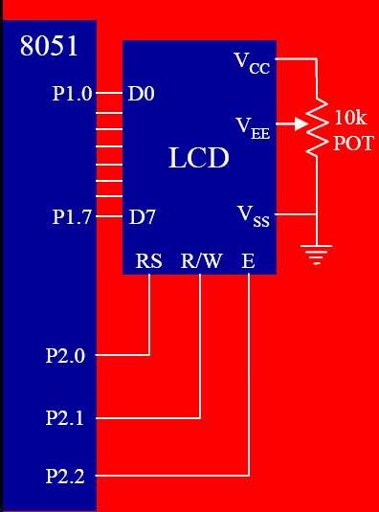
Pin Connections of LCD:

Slide 15
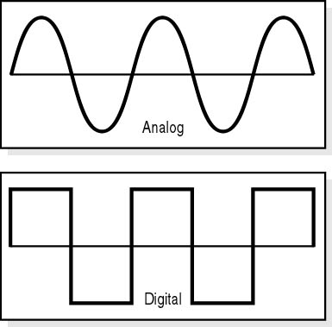
Analog Vs Digital:

Slide 16
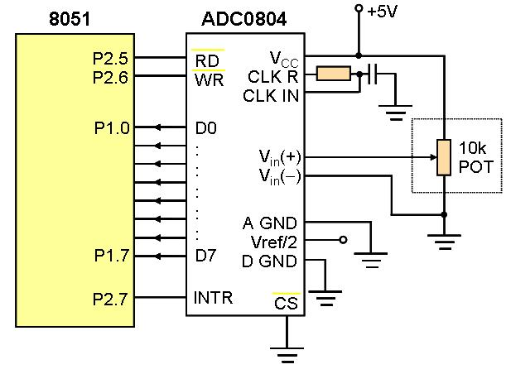
ADC Interfacing:

Slide 17
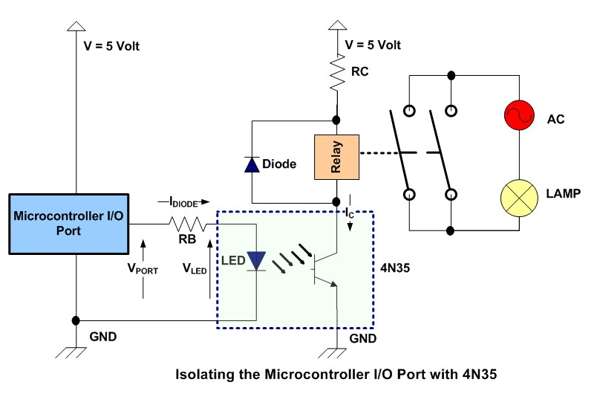
Relay Interfacing:

Slide 18
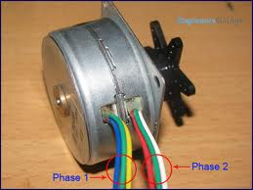
Stepper Motor Interfacing:

Slide 19
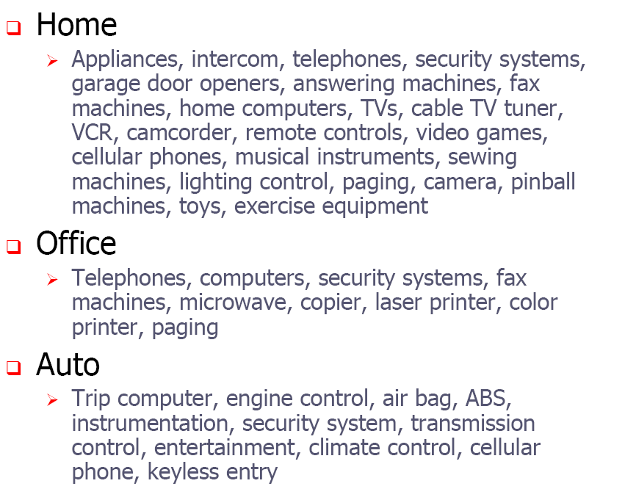
Applications of 8051:

Slide 20

?

Slide 21
THANK YOU

